Slide 1
Customer Booking Behaviour Analysis
Exploration, Modeling, and Evaluation for Improved Predictions

Slide 2
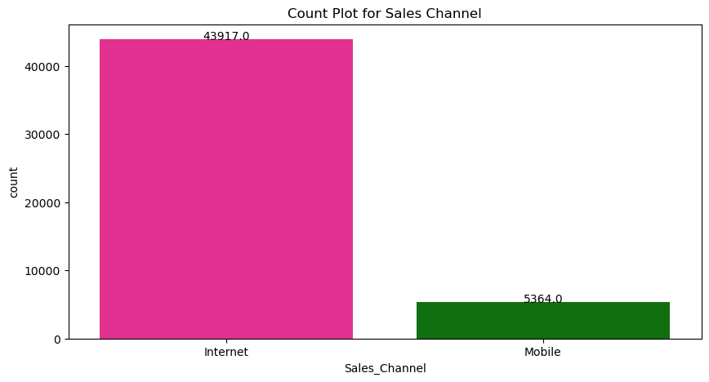
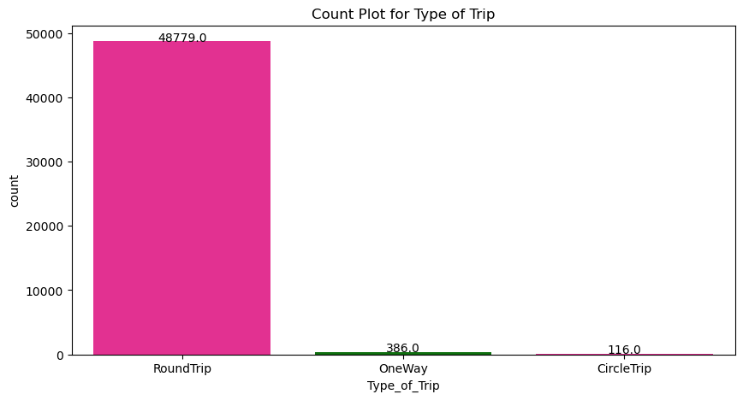
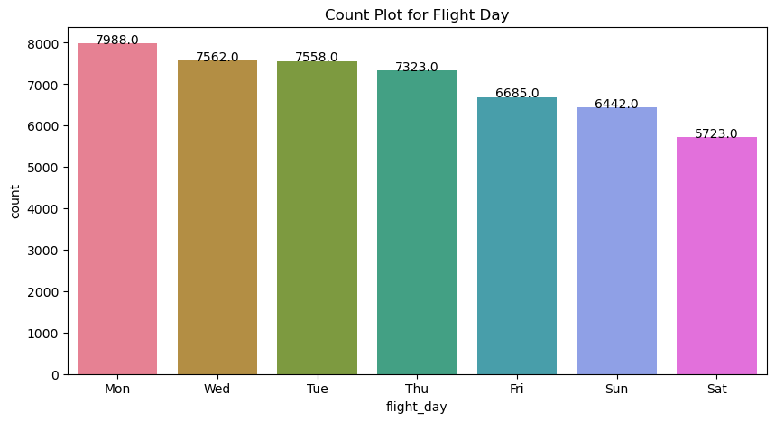
COUNTPLOT

Slide 3
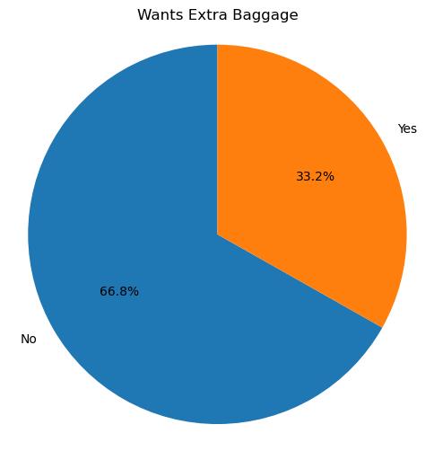
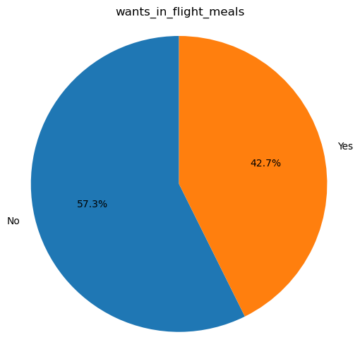
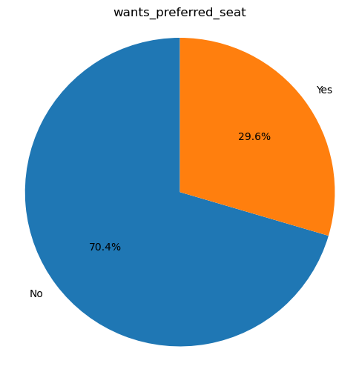
Pie Charts

Slide 4
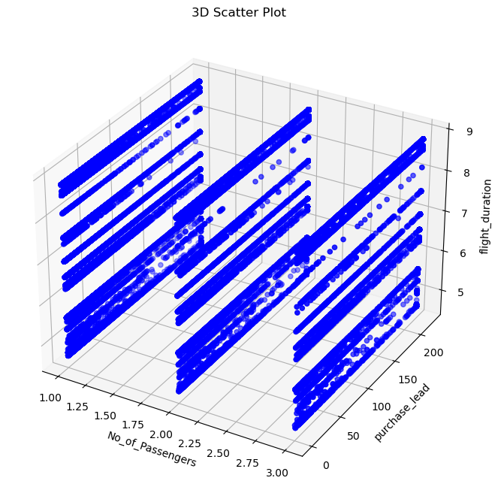
3D Plot for data

Slide 5
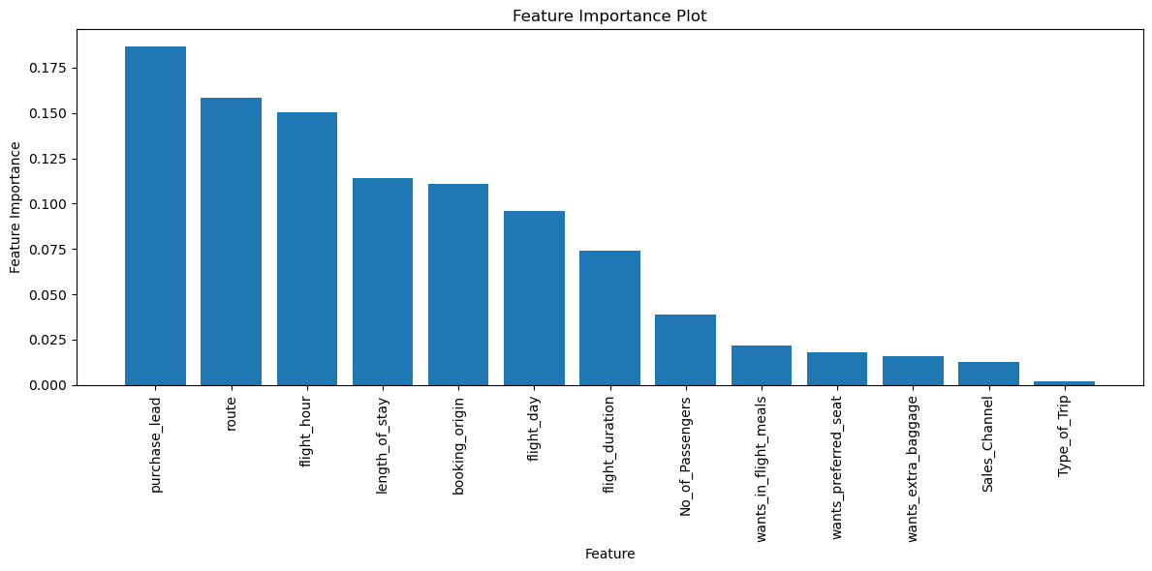
Feature Importance

Slide 6
Conclusion
After conducting an in-depth analysis of the predictive model for customer booking behavior, we have obtained valuable insights and metrics that shed light on the model's performance.
Model Performance Metrics:
Accuracy (0.85): The model achieves a high overall accuracy of 85%. This metric measures the proportion of correctly predicted instances out of all instances. While accuracy is important, it should be interpreted alongside other metrics for a comprehensive evaluation.
Precision (0.46): Precision represents the ratio of correctly predicted positive bookings to the total predicted positive bookings. In this case, the model has moderate precision, indicating that it correctly identifies some positive bookings but also generates false positives.
Recall (0.08): Recall, also known as sensitivity or true positive rate, measures the proportion of actual positive bookings that the model correctly identifies. The low recall indicates that the model struggles to capture all positive bookings.
F1-score (0.14): The F1-score is the harmonic mean of precision and recall. It provides a balance between precision and recall. The low F1-score suggests a trade-off between these two metrics, highlighting the model's challenges in achieving both high precision and high recall simultaneously.

Slide 7
Thank you!

